Slide 1
Why Learn Latex?
Latex is used all over the world for scientific documents, books as well as many other forms of publishing.
One of the most important reasons people use latex is that it separates the content of the document from the style.
Some of you will be using latex in cs70 .

Slide 2

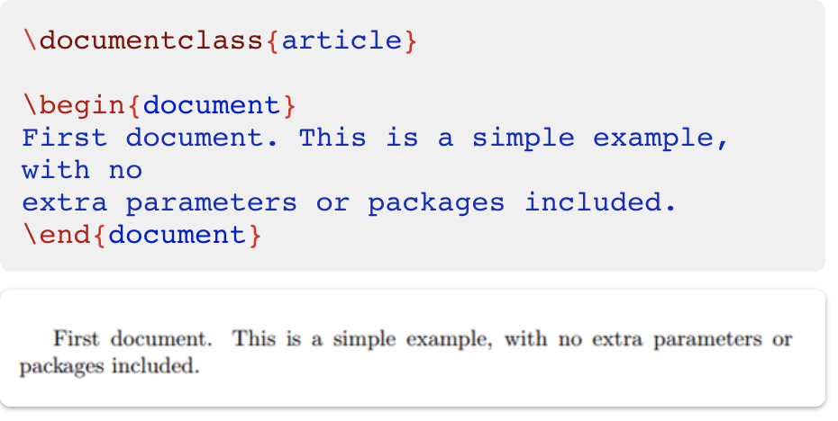
WRITING YOUR FIRST PIECE OF LaTeX
The first line of code declares the type of document, known as the class. The class controls the overall appearance of the document. Different types of documents require different classes. i.e. CV/resume requires a different class than a scientific paper
After this, you write the content of our document, enclosed inside the \begin{document} and \end{document} tags. This s known as the body of the document.

Slide 3
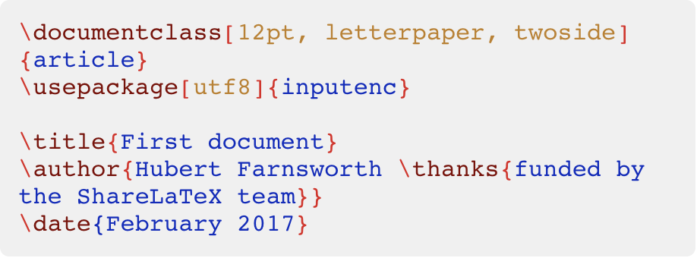
ADDING A TITLE, AUTHOR AND DATE
\USEPACKAGE - This is the encoding for the document. It can be omitted or changed to another encoding but utf-8 is recommended.
\TITLE – The name says it all.
\AUTHOR - Here you put the name of the Author(s) and, as a optional parameter, you can add the next command.
\thanks: This can be added after the name of the author, inside the braces of the title command. It will add a superscript and a footnote with the text inside the braces. Useful if you need to thank an institution in your article.
You can enter the date manually or use the command \today so the date will be updated automatically at the time you compile your document
Now that you have given your document a title, author and date, you can print this information on the document with the \maketitle command. This should be included in the body of the document at the place you want the title to be printed.

Slide 4
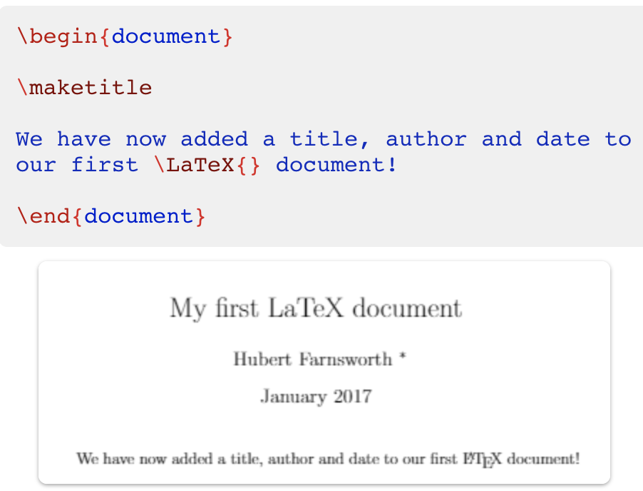
YOU WOULD GET SOMETHING LIKE THIS

Slide 5
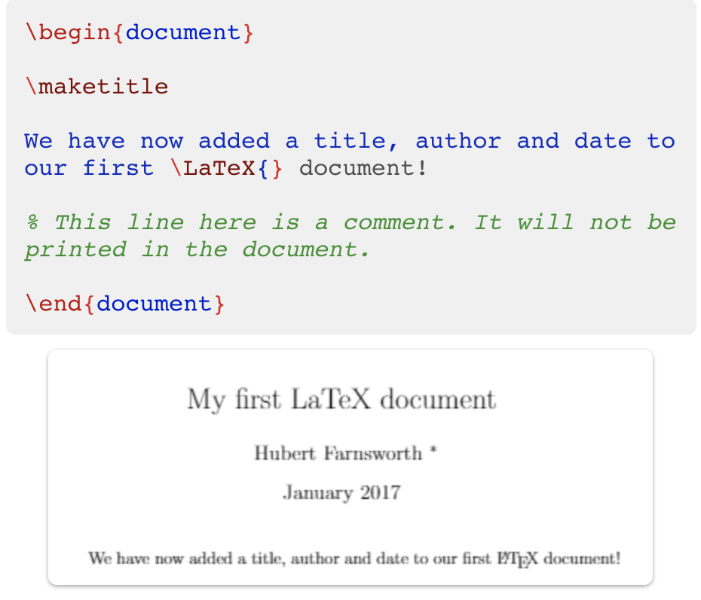
ADDING COMMENTS

Slide 6
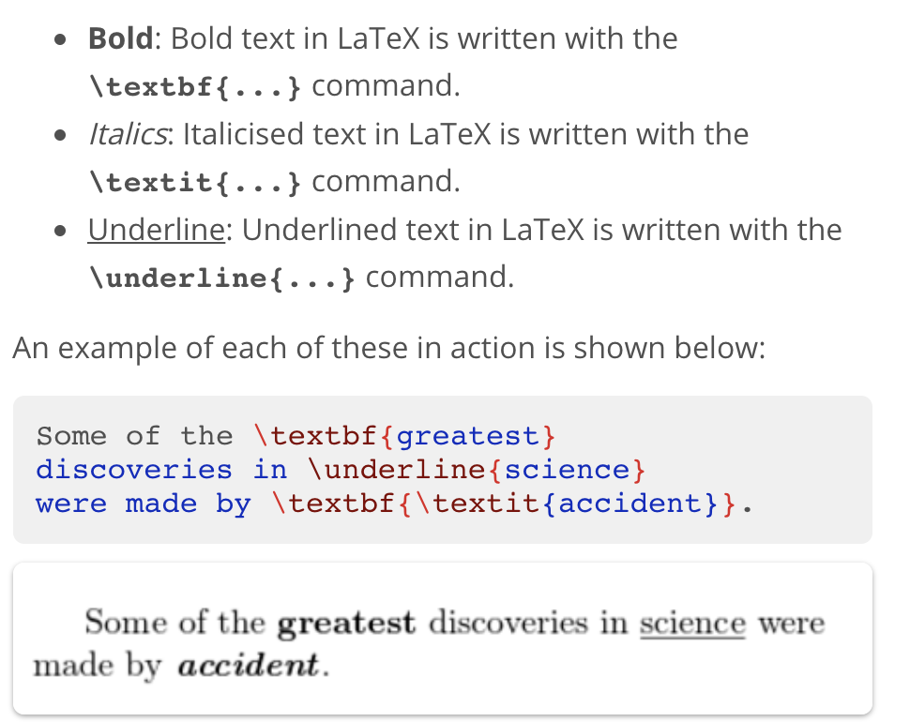
BOLD, ITALICS and UNDERLINING

Slide 7

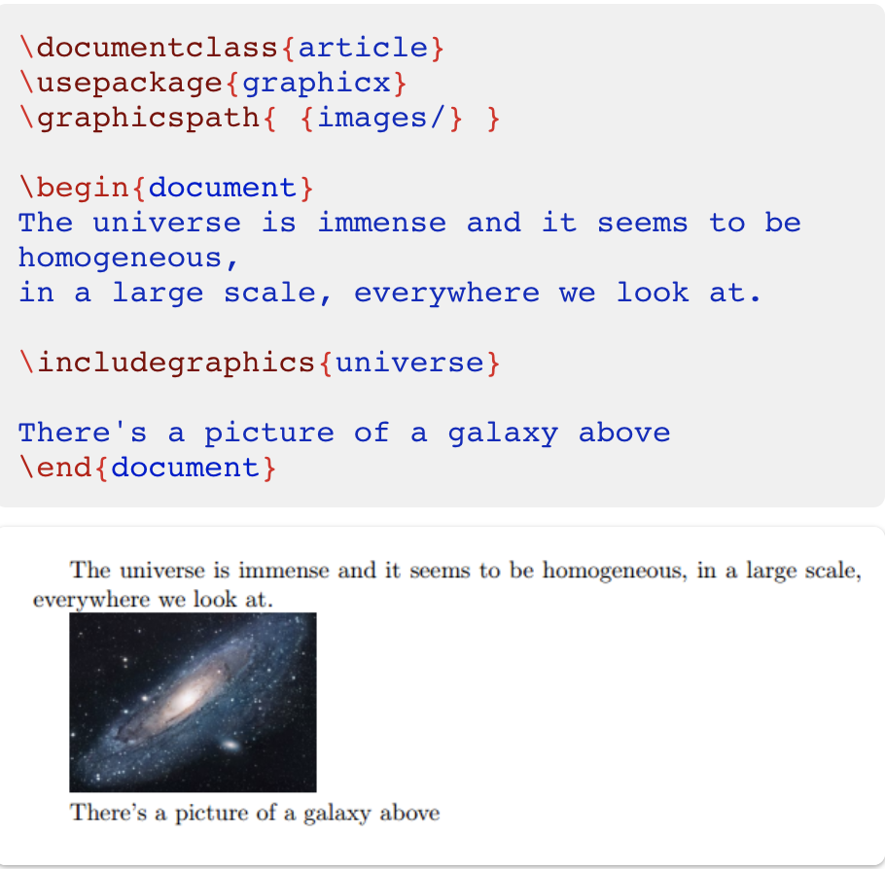



ADDING IMAGES

Slide 8
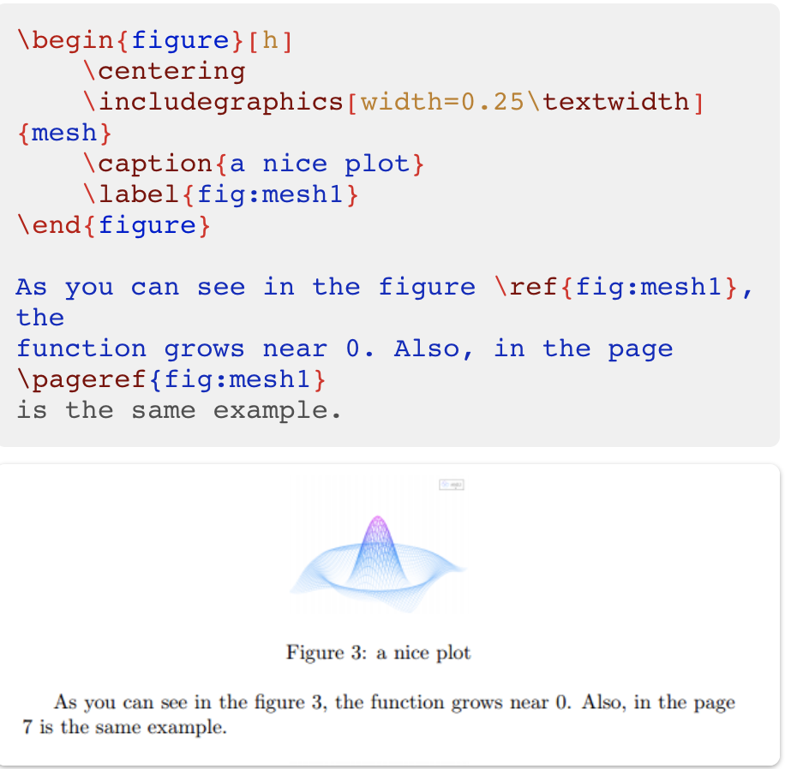
CAPTIONS, LABELS AND REFERENCES
\caption{a nice plot}: As you may expect this command sets the caption for the figure. If you create a list of figures this caption will be used there. You can place it above or below the figure.
\label{fig:mesh1}: If you need to refer the image within your document, set a label with this command. The label will number the image, and combined with the next command will allow you to reference it.
\ref{fig:mesh1}: This code will be substituted by the number corresponding to the referenced figure.

Slide 9
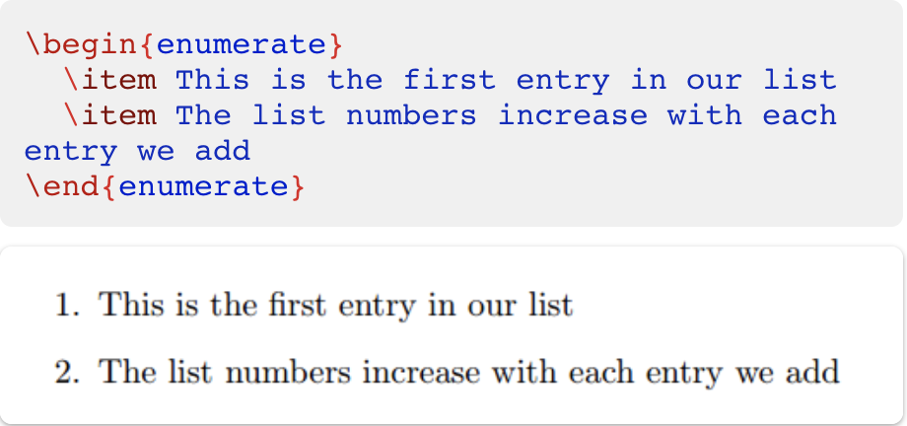
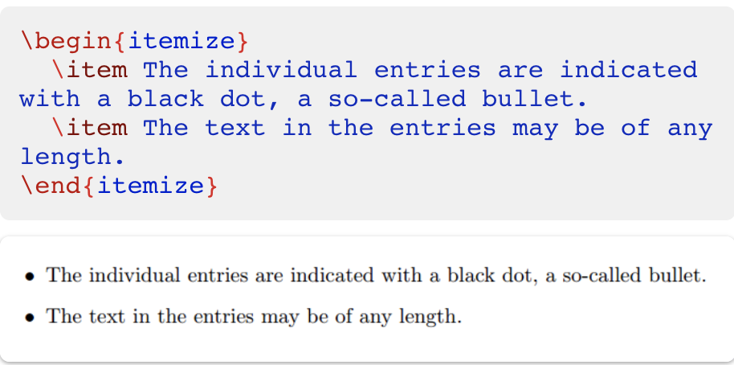
CREATING LISTS
ORDERED LISTS
UNORDERED LISTS

Slide 10
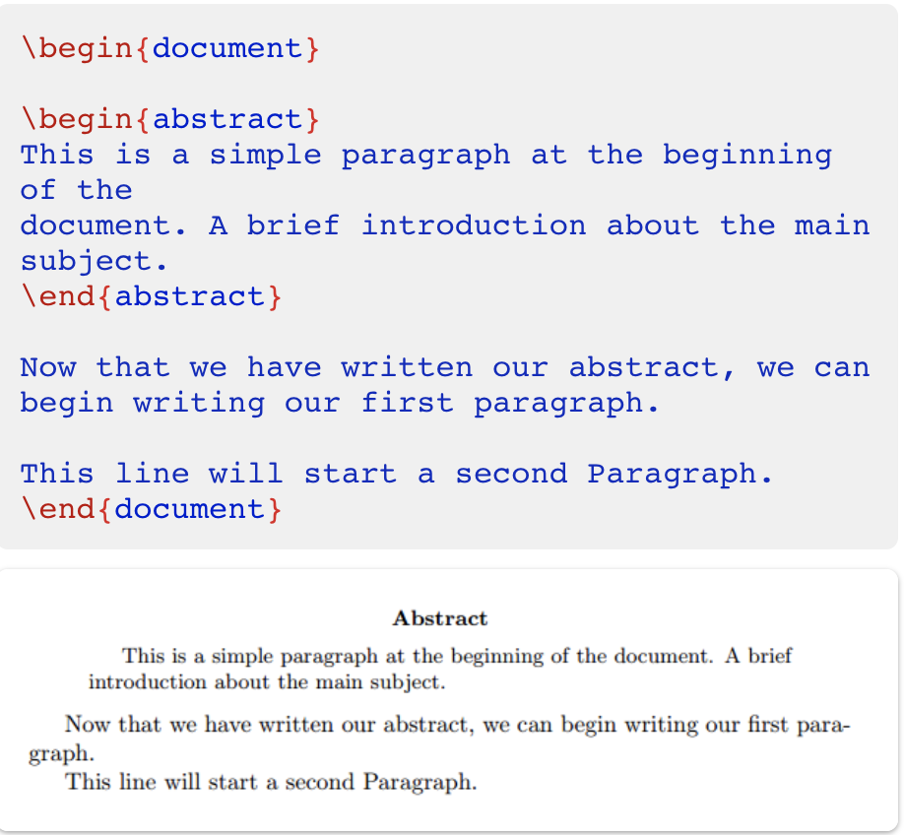
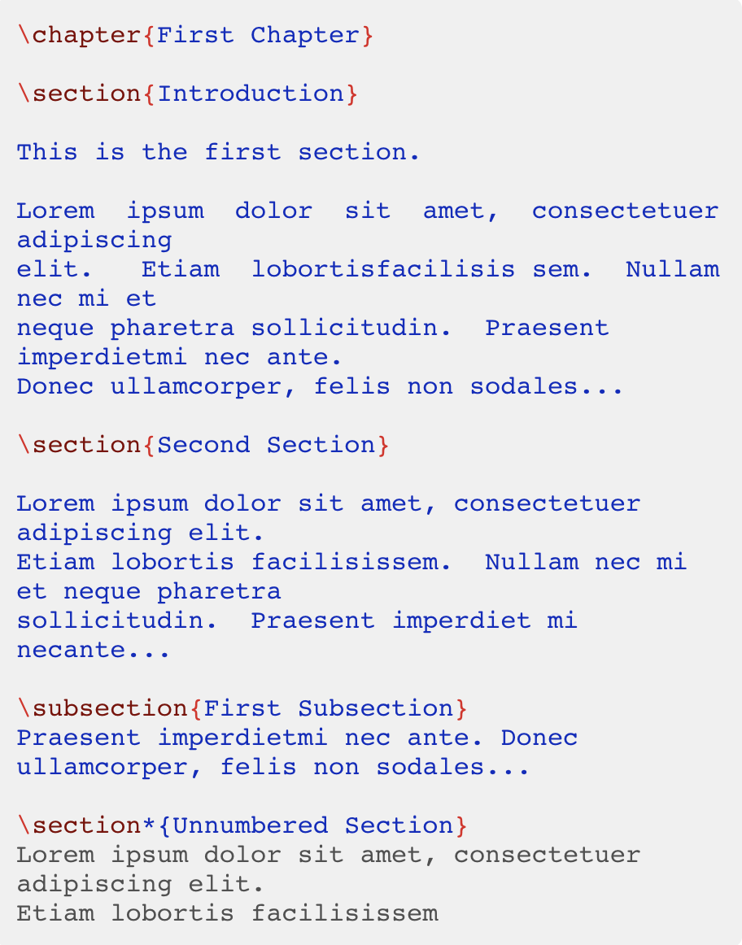
BASIC FORMATTING

Slide 11
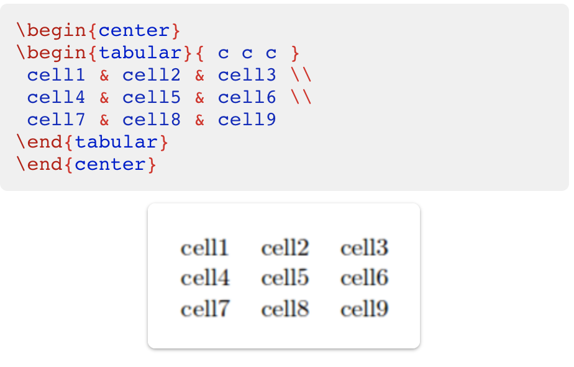
CREATING TABLES

Slide 12
SOME RESOURCES
The following are links to my favorite LaTeX tutorial. They cover the most basic to slightly advanced LaTeX, which you may need in this course.
https://www.overleaf.com/latex/learn/free-online-introduction-to-latex-part-1
https://www.overleaf.com/latex/learn/free-online-introduction-to-latex-part-2
https://www.overleaf.com/latex/learn/free-online-introduction-to-latex-part-3
If you get stuck, Stack Overflow may be one of your best friends.

